Slide 1
Chapter 1 quality control
Roselyn Aperocho-Naranjo, RPh, MPH
www.roselynnaranjo.vze.com

Slide 2
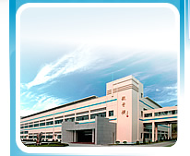
Organizational chart of a manufacturing plant
MANUFACTURING FIRM
Finance
Plant Department
Quality Assurance/Control
Marketing

Slide 3
Organizational chart of a manufacturing plant
MANUFACTURING FIRM
Finance
Plant Department
Quality Assurance/Control
Marketing

Slide 4
Organizational chart of a manufacturing plant
MANUFACTURING FIRM
Finance
Plant Department
Quality Assurance/Control
Marketing

Slide 5
Organizational chart of a manufacturing plant
Quality Control Manager
Quality Assurance/Control
Control Functions
Materials Inspection Section
Analytical Laboratory
Analysis
Monitoring
Biological Testing Laboratory
Record review & release
Spec & Analytical Dev’t
Audit functions
Quality Coordinating Office
CGMP

Slide 6
Organizational chart of a manufacturing plant
Quality Control Manager
Quality Assurance/Control
Control Functions
Materials Inspection Section
Analytical Laboratory
Analysis
Monitoring
Biological Testing Laboratory
Record review & release
Spec & Analytical Dev’t
Audit functions
Quality Coordinating Office
CGMP

Slide 7
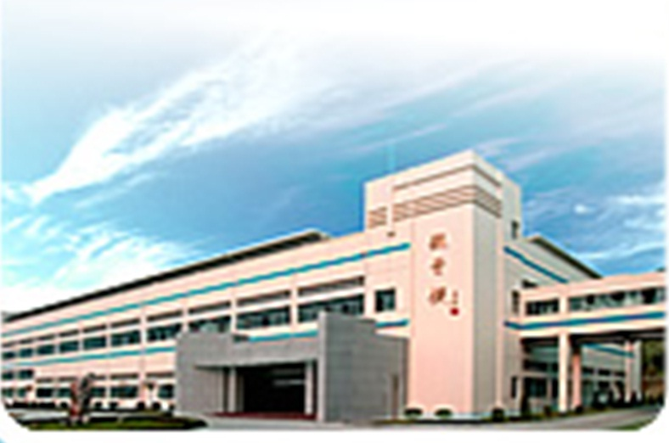
QUALITY
QUALITY CONTROL
...characteristic of a product which is comparable to a standard in measuring the uniformity of a product and determine its degree of acceptability
QUALITY CONTROL
...is a tool which gives the assurance that a product conforms to standards and specifications through a system of inspection, analysis and action

Slide 8
QUALITY CONTROL
Eliminates the risk of marketing unsafe products
Guarantee conformances to regulatory requirements
Benefits of having a Quality Control Department
Ensure product efficacy & safety
Reduce operating costs & losses
Produce higher employee morale
Motivate medical professions to prescribe or sell the product

Slide 9
Standards & specifications
QUALITY CONTROL
TESTING METHOD
Analytical & Laboratory Tests
PACKAGING MATERIAL
Run on high speed, functional,
compatible w/ the product, protect stability, ship well
FORMULA
Concise & precise statement of ingredients
RAW MATERIAL
Within the permisible range of purity
FINISHED PRODUCT SPECS
Performance,
purity,safety & stability
S O P
Step by step method in the formulation of a product

Slide 10
QUALITY CONTROL
DEFECTS
MEASURABILITY
Variable Defect – can be measured by instrument like
heigth, thickness, concentration, volume, pH
Attributive Defect – cannot be measured by instrument
ex. Color, clarity,smoothness,taste, cleaniliness
SERIOUSNESS/GRAVITY
Minor Defect – do not endanger life or property.
Ex. Slight change in label color
Major Defect – affects the functions of the product.
Ex. Crack in a bottle
Critical Defect – endanger life or property & may become non-functional. Ex. Absence of warning
MEASURABILITY
Performance Defect – function. Ex. Supposiitory
doesn’t melt at boy temperature
Internal Defect – not visible. Ex. Subpotent drug product
Ocular Defect – visible. Ex. Foreign matter in syrups

Slide 11
QUALITY CONTROL
Sources of Product Variation
Sources | Example
Materials | Variation between supplies of same substance Variation between batches from same supplier Variation within the batch
Machines | Variation of equipment for same process Different adjustment of equipments Aging and improper care
Methods | Inexact procedures Inadequate procedures Negligence by chance
Men | Improper working conditions Inadequate training and understanding Dishonesty, fatigue and carelessness

Slide 12
QUALITY CONTROL
Material Inspection Section
Examine raw materials
Conduct physical tests (packaging materials,
manufacturing, filling & packaging operations
Maintain periodic examination on inventories (storage, shipping & distribution)
To audit the work done by the production personnel

Slide 13
QUALITY CONTROL
Analytical Laboratory
Accesible
Protected from noise & vibrations
METHOD
Gravimetric & Volumetric Analysis
Redioactive tracer & Chromatography
Ultraviolet & Infrared Spectrophotometry
Auto-analysis
Polarography
X-ray Difraction
X-ray flourescence
Spectrophotoflourimetry

Slide 14
QUALITY CONTROL
Biological Testing Laboratory
well-trained & experienced personnel in microbiologic procedures & biological interactions
FUNCTIONS
Evaluate microbiological assay, sterility, pyrogen and bacteriological test , safety & acute toxin tests.

Slide 15
QUALITY CONTROL
Specification & Analytical Development
Coordinate with research for the development of new product
Establish specification for raw and packaging materials
Validate existing procedures

Slide 16
QUALITY CONTROL
Quality Coordination Office
Maintain & store records in the manufacturing process
Furnidh data to in analyzing product performance
Investigate consumer complaints
Appoint development for enough production of drugs at a specified time
Provide data relating to scientific & legal issues

Slide 17
QUALITY CONTROL
Basic Categories of Control Functions
Analysis Function
Monitor Function
Ensure the acceptability of a product
Sample & examine materials while on process.

Slide 18
QUALITY CONTROL
Basic Categories of Control Functions
RRR Function
Audit Function
Embrace the legal requirements set by the CGMP regulating bodies.
Record, Review & Release
Reviw batch record in a lot

Slide 19
QUALITY CONTROL
PREPARE FOR A QUIZ

